Slide 1

Eco-Wild Guard
An Automated Early-Warning & Roadside Mitigation Safety System for High-Risk Transit Corridors

Slide 2
Problem Statement
Mpumalanga has major transport and heavy-haulage routes that pass alongside or through areas where wildlife naturally moves. This creates a dangerous interaction between wildlife movement and heavy road traffic
According to the Endangered Wildlife Trust (EWT), database recorded 8,569 wildlife roadkill incidents between 2012 and 2024 across the Bakwena N1/N4, TRAC N4 and N3 toll routes.
Which result in wildlife deaths and injuries, danger to vehicle occupants, vehicle damage, traffic disruption and financial losses.

Slide 3
Solution
We propose the solution of ‘eco-WildGuard’ which is a smart wildlife and heavy-haulage safety system.
detects wildlife near high-risk road crossings and sends an early warning to approaching trucks
Eco-Wild Guard combines roadside motion intelligence with real-time telematics to prevent catastrophic collisions before trucks reach high-risk crossing zones.

Slide 4






System methodology
A multi-layered architectural approach integrating roadside IoT, long-range telemetry, and 3D spatial twin mapping.
PIR & Motion Array
Edge Intelligence
5km Telemetry
We have motion sensors placed along known crossing routes to detect animal movement day and night.
On-device AI analyze movement vector and thermal footprints to filter out non-hazardous movement and false positives.
Instant long-range wireless broadcast transmits real-time alerts to approaching heavy haulage trucks 5 kilometers out.

Slide 5

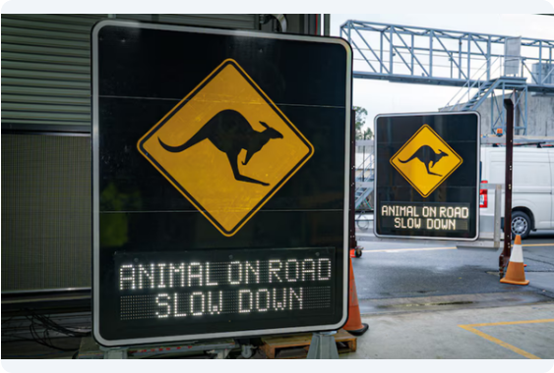
Automated Roadside Triggers
Physical Boom Gates: Deploys automated physical barriers to temporarily hold traffic during verified large-herd crossings.
Variable Speed-Limit (VSL) Signs: Dynamically updates roadside LED displays to lower speed limits from 80 km/h to 30 km/h.
In-Cab HUD Warnings: Sends audible and visual hazard distance counts directly into approaching truck cabs.
Automated Reset: Re-opens corridor and resets speed limits once roadside motion sensors confirm clear pathways.

Slide 6
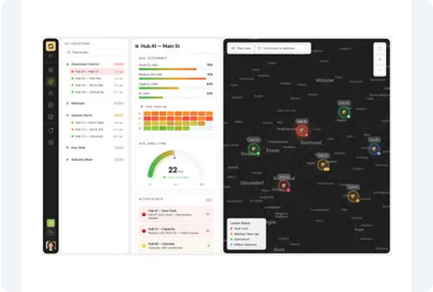
3D Spatial Fleet Tracking
Real-Time 3D Corridor Twin: Interactive spatial mapping provides dispatch centers full real-time visibility into active wildlife triggers.
Fleet Compliance Auditing: Tracks individual truck speed responses, braking behavior, and driver adherence to automated VSL warnings.
Predictive Corridor Analytics: Heatmaps animal crossing trends over time to optimize fleet scheduling during peak wildlife activity.

Slide 7




Automated Safety Sequence
2. Early Warning
4. 3D Spatial Audit
5km telemetry broadcast alerts approaching coal trucks instantly.
Real-time telemetry maps event logs to logistics dispatch HQ.
1. Detection
3. Physical Trigger
Roadside PIR & motion sensors detect animal movement near transit path.
Automated boom gates lower & VSL signs drop speed limits.

Slide 8


Business & Market Model
Commercialisation Model
Monthly subscription from mining & transport companies
Mining companies and logistics companies pay a monthly fee per truck or per fleet to use the system.
On Installation fee:
When a company joins, we charge an initial fee for installing the technology, such as:
GPS integration
Sensors/cameras where required
Software setup
Target Market & ESG Value
Government and road Authorities
.Mining and coal companies
Heavy-Haulage and Logistic companies

